Slide 1



Kaggle Winner Presentation (5th) NeurIPS 2024 - Predict New Medicines with BELKA https://www.kaggle.com/competitions/leash-BELKA
HENG CHER KENG https://www.kaggle.com/hengck23
Notes:
Recommending picking out he most interesting and important parts from your documentation.

Slide 2
Agenda

Slide 3
Agenda
Background
Summary
Feature selection & engineering
Training methods
Important findings
Simple model
Code review

Slide 4
Background

Slide 5
Background
◆ Contract computer vision and deep learning algorithm engineer. - identify fracture in x-ray images
- implement visual slam for robotic navigation
- finetune LLM models
◆ Familiar with deep learning and build deep models in my work.
◆ Experiences previous Kaggle competitions. Sequence modeling in molecule and medicine applications:
- Bristol-Myers Squibb – Molecular Translation - OpenVaccine: COVID-19 mRNA Vaccine Degradation Prediction

Slide 6
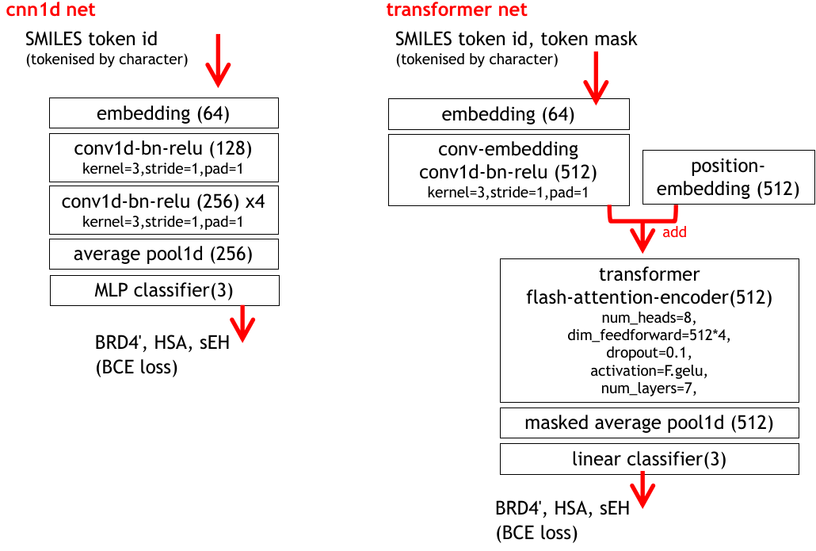
Summary
◆ To mitigate the effects of OOD (out-of-domain distribution), we use ensemble of different sequence models:
- 3-fold conv1d net - 2-fold transformer net - single-fold mamba (SSM, selective state machine)
◆ To handle 98 millions of training molecules efficiently, we use customized cuda kernel from open source flash attention[1] and mamba SSM[2] libraries

Slide 7
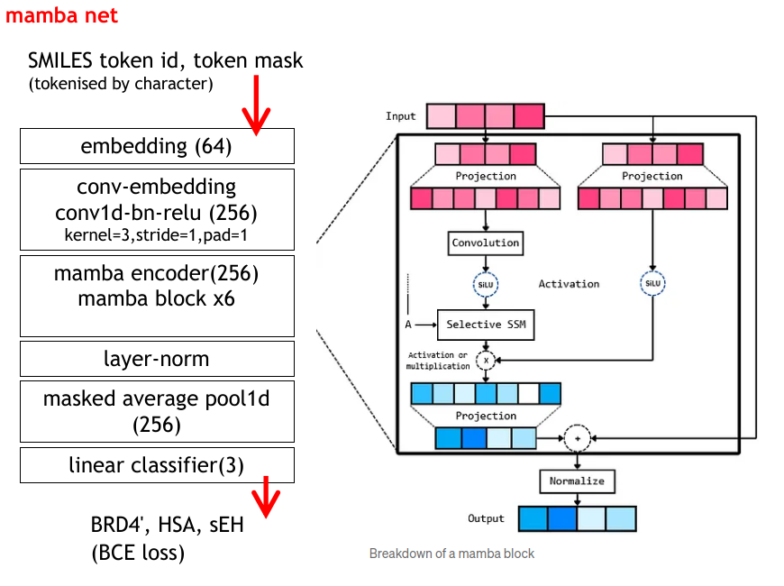
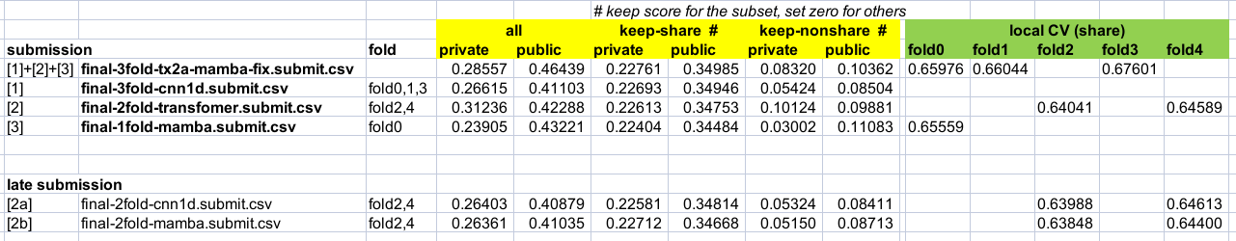
◆ For training we have two Nvidia Ada A6000 / 48 GB Ampere GPUs. Time for training one fold with single GPU are:
- 7 hr for cnn1d,
- 28 hr for transformer,
- 36 hr for mamba.

Slide 8
Features Selection/
Engineering

Slide 9
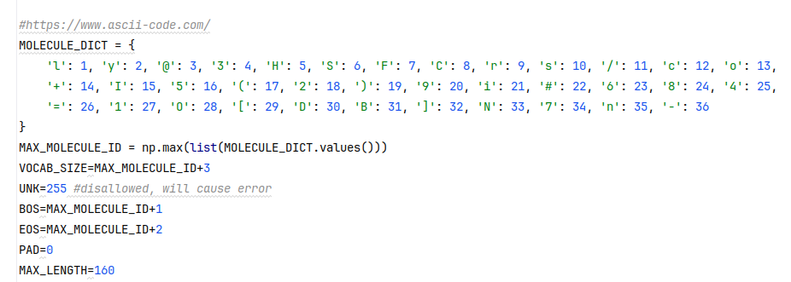
Features Selection/Engineering
◆ Tokenization : We tried several methods like character based, sentence piece, byte-pair-encoding (BPE), atom/smiles notation aware to break the SMILES strings. Surprisingly, the simplest character based tokenization performs the best across different net architecture
Add a conv1d layer of kernel size=3, stride=1 to learned combinations of consecutive tokens (bi-grams, tri-grams) before passing them into cnn1d, transformer or mamba encoder.

Slide 10
Features Selection/Engineering
Features Selection/Engineering
Variable Importance Plot
◆ Batch normalization: cnn1d model performance is sensitive to batch normalization. Different feature values for:
- in-distribution and out-distribution samples.
- +ve and -ve samples due to class imbalance (less than 1% +ve).
To alleviate the problem, we use high eps=5e-3 and low momentum=0.2

Slide 11
Training Methods

Slide 12
Training Methods
◆ binary cross entropy loss with ADAM optimizer.
- step learning rate of 1e-3,1e-4,1e-5 for 6-12 epochs.
- large batch size of 2000,2500,5000 Interesting, the best way to handle class imbalance is to do nothing (no up-sampling or under-sampling of the class). Maybe because of the large batch size we used.
Kaggle Winner Presentation Template

Slide 13
Important and Interesting Findings

Slide 14
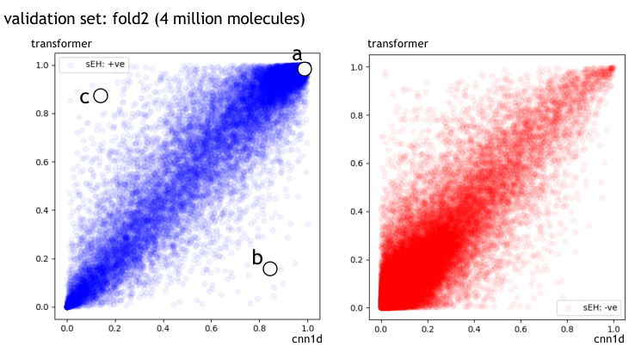
Important and Interesting Findings
◆ Transformer is the most robust
◆correlation of cnn1d and transformer predictions
Kaggle Winner Presentation Template

Slide 15
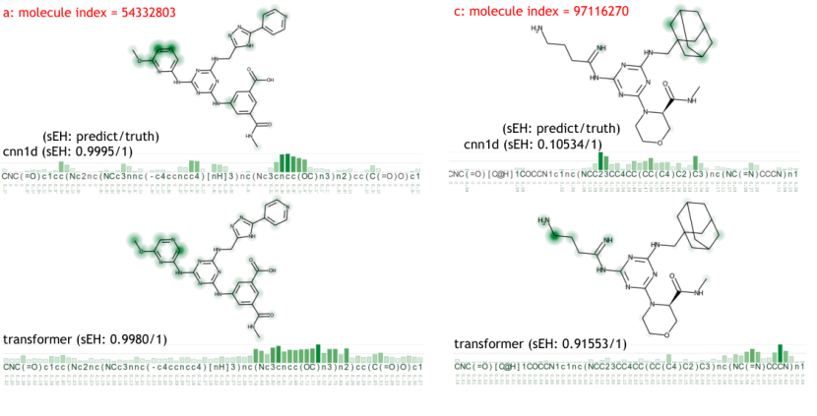
Important and Interesting Findings
◆ Generate the net prediction heatmap using GradCAM[3] and visualize it with XSMILES[4]. cnn1d has local activations, whereas transformer has more global ones.

Slide 16
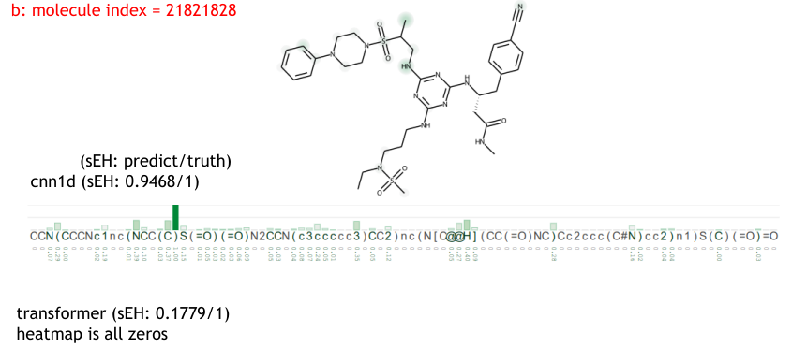

Slide 17
Simple Model

Slide 18
Simple Model
◆ Just transformer alone is good enough!

Slide 19
Code Review

Slide 20
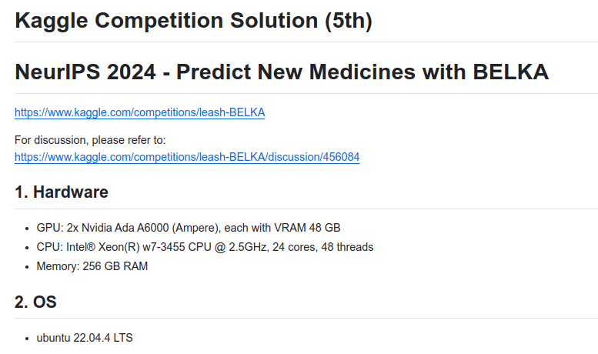
https://github.com/hengck23/solution-leash-BELKA

Slide 21
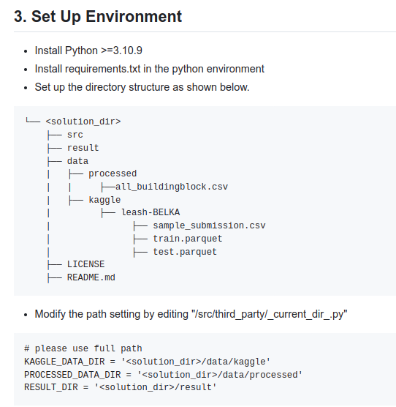
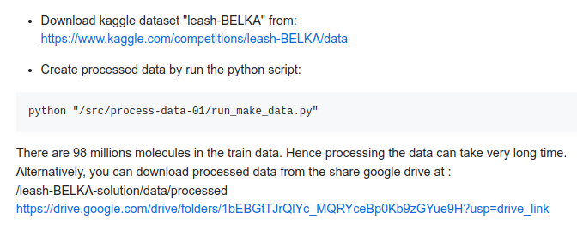

Slide 22
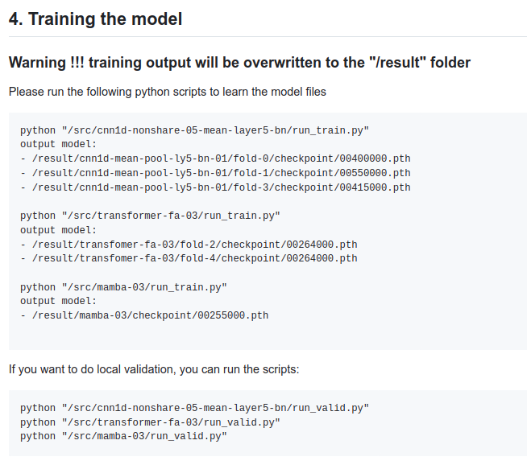

Slide 23
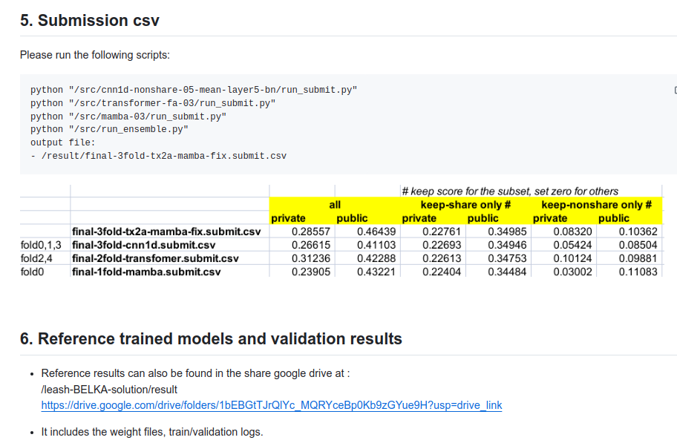

Slide 24
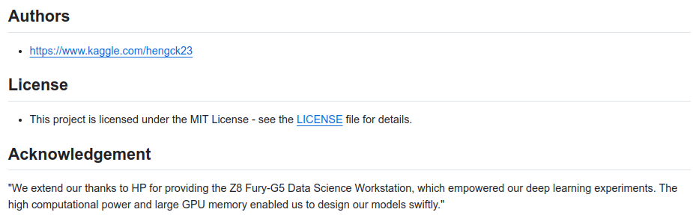

Slide 25
Question and Answer

